Slide 1
MP3 Player
Mark Anderson
Carlos Vigil
Michael DeMeis

Slide 2
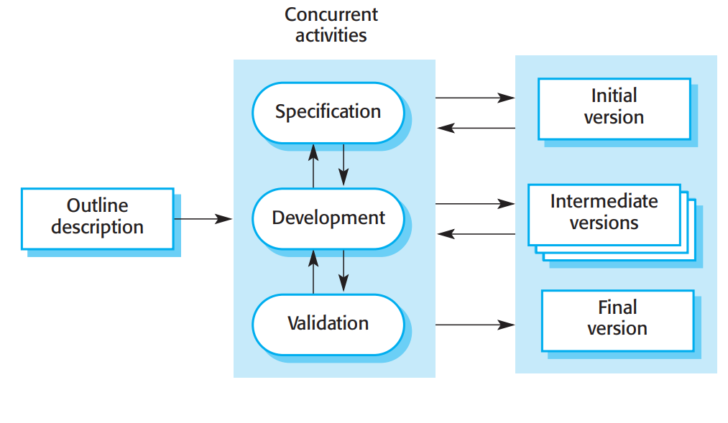
Process Model
Incremental Process Model
Ability to go back and forth with client
Develop multiple versions
Break up software into increments

Slide 3


Project Management
Mark - Team Leader & Developer
Carlos - Developer
Michael - Developer
Group chats
Google Drive
Future in-person meetings

Slide 4
Schedule
Build UI - 2 weeks (first week of November)
Functional Features - 2 weeks (3rd week of November)
First version client check - 1 week (Last week in November)
Tweak per their feedback - 1 week(First week of December)
Hand over final version to client - 1 week(Second week of December)
Present to class - Finals week.

Slide 5
Risk Analysis
Risk | Probability | Effects
Time Required to develop the software is underestimated | Low | Serious
Accepting multiple types of audio file formats | Moderate | Tolerable
Changes to requirements that require major design rework | Low | Serious

Slide 6
Deliverables
A working music player, as an executable program, that allows the user to open audio files for listening through their computer.
A functioning user interface that allows playing, pausing, and skipping of audio files.

Slide 7
User Stories
Eric opens the music app on his computer. He has files he wants to play and drags them onto the app. The audio files load into a queue with the first one ready to play. Eric clicks on the play button and can hear the files playing through an audio device connected to his computer. He closes the app when it’s done.
Sandy double-clicks on an audio file and it starts playing in the app. She can pause the playing of the file and adjust her volume setting by clicking on buttons. She can close the app after listening.

Slide 8
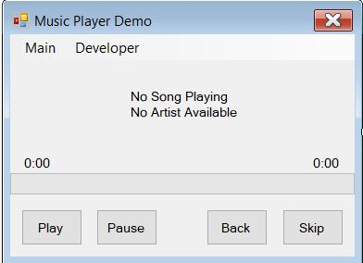
Functional Requirements
Import .mp3 files
Play button
Pause button
Volume control
Skip button

Slide 9
Non-Functional Requirements
Used as default media player on PC
Easy to use UI
Be able to execute .mp3 files

Slide 10
Use cases
User opens the installed application. Using an audio file stored on the computer the user drag-and-drops into the app. The file plays until the end. The user can close the app at any time.
The user double-clicks a file and the application opens with the file playing. The user can close the app at any time.

Slide 11
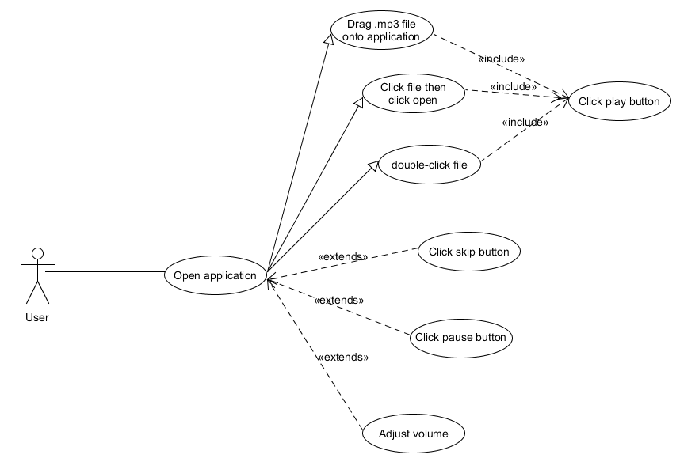
Use case diagrams

